Slide 1
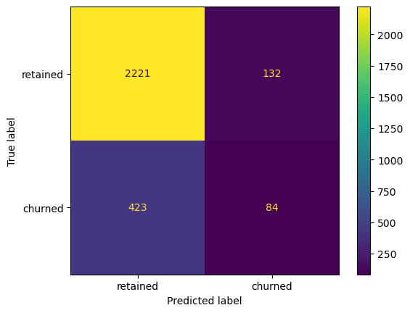
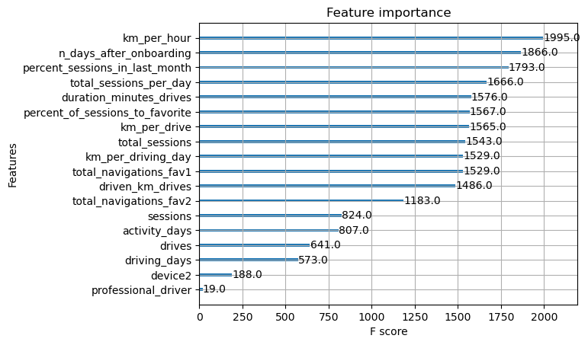
Waze Churn Prevention
Decision Tree Modeling
Project Overview
This report contains information regarding the results of decision tree models being used to predict user churn.
Several new features created:
km_per_driving_day
km_per_hour
km_per_drive
percent_sessions_in_last_month
total_sessions_per_day
No need to consider outliers due to the nature of decision trees
Categorical data encoded
Data split into 60% train, 20% validation, 20% test
Only correctly identified 17% of churned users
New features tend to have higher importance to the model
Use model for future research into useful features
Try splitting the data into different proportions
Try a different model to see if it can predict churn better

